Slide 1
Introduction to Networks and Wireshark
Unit 6.1
Cybersecurity Boot Camp |

Slide 2

Welcome Back!
So … where are we again?

Slide 3


Previously on Cybersecurity…
Terminal, Python, Crypto
Notes:
Recap previous week (bridge)

Slide 4
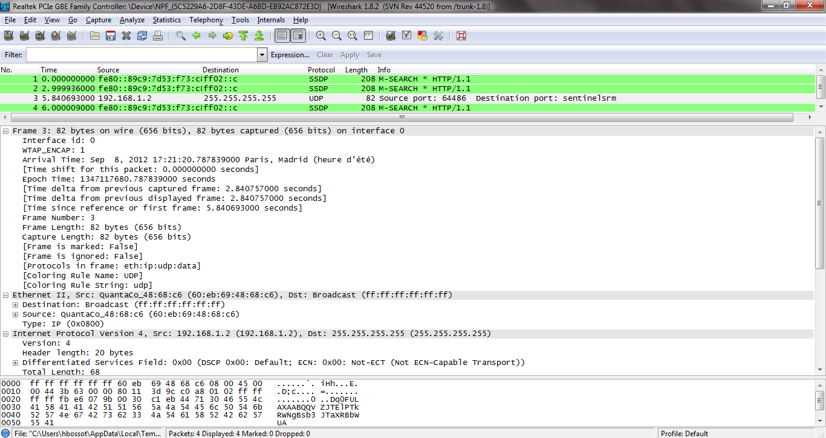

This Week on Cybersecurity…
Networking, Wireshark
Notes:
Talk about what’s upcoming this week

Slide 5
Where are we?
Security Analyst | Security Operations Center (SOC) Analyst | Security Engineer | Systems Engineer
Cyber Threat Analyst | Cyber Defense Analyst | Incident Response Analyst | Intelligence Analyst
Information Assurance Technician | Risk Analyst | Forensics Investigator | Systems Administrator
Network Engineer | IT Auditor | Application Security Engineer | Penetration Tester
Information Analyst | Systems Security Analyst | IT Specialist | Web Engineer – Application Security
Networking is critical for nearly all of these roles. A solid understanding of networking is fundamental to almost all of cybersecurity.
Notes:
Talk about where we are in the context of the overall course (networking – learning how computers communicate) Blue squares denote areas where these skills are particularly relevant.

Slide 6
Today’s Goals
By the end of class, you will be able to:
Define networks and understand the principles by which computers communicate
Explain the relevance of protocols and ports in network communication
Define and explain each layer of the OSI model
Explain the steps of network communication in the context of the OSI Model
Capture communication over the network using Wireshark
Explain the basics of a packet in Wireshark
Notes:
But today, we’re going to… Review goals, address questions.

Slide 7
The Journey of a File

Slide 8

Network
How does a file get from my computer to yours?

Slide 9
Network
No magical floating “cloud” raining files on you.
Computers send files to each other over a network

Slide 10

Network
A network is a group of devices that can communicate.

Slide 11

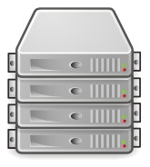
Network Communication
Client
Server
Much of network communication happens between clients and servers

Slide 12
Network Communication
Client
Server
Clients and servers communicate back and forth

Slide 13


Network Communication
Often, multiple clients communicate with a single server
Notes:
Phone, computer, smart bulb …

Slide 14


Network Communication
Client/Server Model
Magic … for now

Slide 15
Network Communication
Request/Response
1
The client sends a request for info to the server
The server responds with data
2

Slide 16
Network Communication
Request
I’d like file X please

Slide 17

Network Communication
Response
Let me find file X for you…
I’d like file X please

Slide 18

Network Communication
Response
I’d like file X please
Here’s file X you asked for!

Slide 19

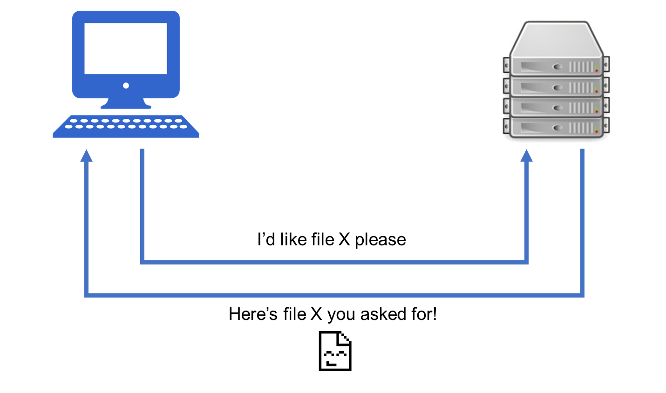
Request/Response
How is this request made? How is it sent?
How does the client find the server, and vice-versa?
Actual process is … more in depth. Lots of magic in our current understanding. But we’ll get there!
How is this file found? How is it sent?

Slide 20
Activity: Explaining Communication (10 min)
With a partner, investigate and explain how each of the following might work in communicating over the network:
File Transfer
Email
Web Page
For each scenario, think about and try to explain each of the following:
Who is the client? The server?
What does the request look like? The response?
What work does the client do? The server?
What is being communicated?
Feel free to use a search engine to help you in your investigation!

Slide 21
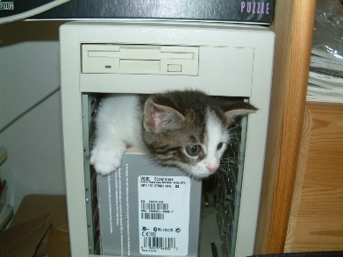
Review Explaining Communication - File Transfer
I’d like file X please
Here’s file X you asked for!

Slide 22
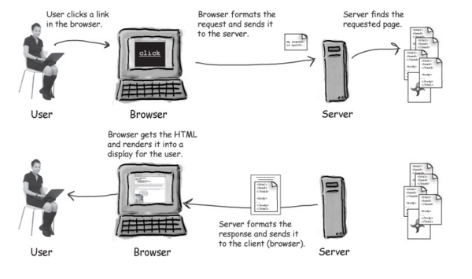
Review Explaining Communication - Web Pages

Slide 23


Review Explaining Communication - Email
Client - Sender Nick
Client – Receiver Peleke
Mail Server
To: peleke@yo.yo From: nick@yo.yo Yo Yo Yo! How it go?
To: peleke@yo.yo From: nick@yo.yo Yo Yo Yo! How it go?

Slide 24

Review Explaining Communication - Email
Client - Sender Nick
Client – Receiver Peleke
Mail Server(s)
To: peleke@yo.yo From: nick@yo.yo Yo Yo Yo! How it go?
To: peleke@yo.yo From: nick@yo.yo Yo Yo Yo! How it go?
For some types of communication there may be more than one server behind the scenes doing work.

Slide 25

Networking Definitions
Network
A system of computers and other devices (such as printers) that are connected to each other.
Network Communication
Transmission of data between two or more computers over a network.
Client/Server
Multiple end devices (clients) communicating over a network with a single central computer (server).
Request/Response
A basic method of computer communication, in which one computer sends a request for data to a second computer, and the second responds to the request.

Slide 26
Today’s Goals
By the end of class, you will be able to:
Define networks and understand the principles by which computers communicate
Explain the relevance of protocols and ports in network communication
Define and explain each layer of the OSI model
Explain the steps of network communication in the context of the OSI Model
Capture communication over the network using Wireshark
Explain the basics of a packet in Wireshark
Notes:
But today, we’re going to… Review goals, address questions.

Slide 27
Introduction to Protocols

Slide 28
Dispelling the Magic
How is this request made? How is it sent?
How does the client find the server, and vice-versa?
How is this file found? How is it sent?

Slide 29



How Computers Work- Binary
Text? 0s and 1s
Images? 0s and 1s
Music? 0s and 1s

Slide 30

Why Binary?
Notes:
Explain that the reason we use 0s and 1s is tied to how electrical circuits work

Slide 31
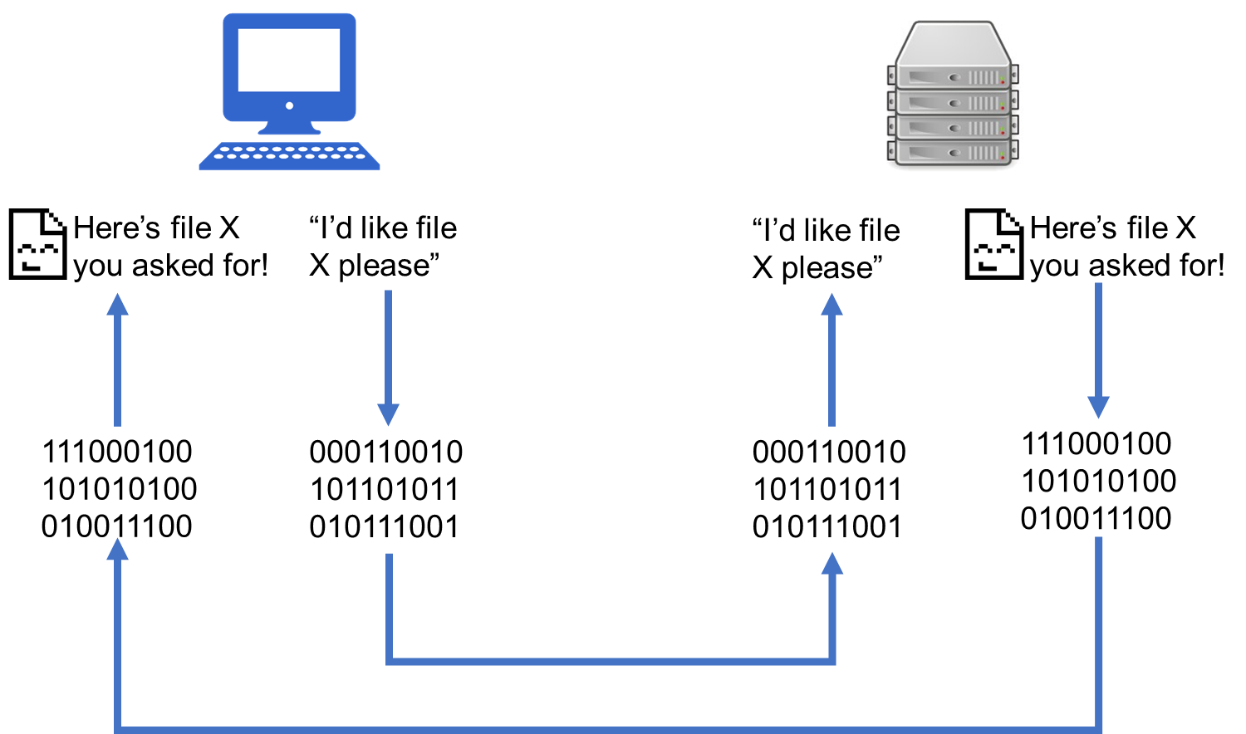
Request/Response and Binary

Slide 32

Protocols in Networking

Slide 33
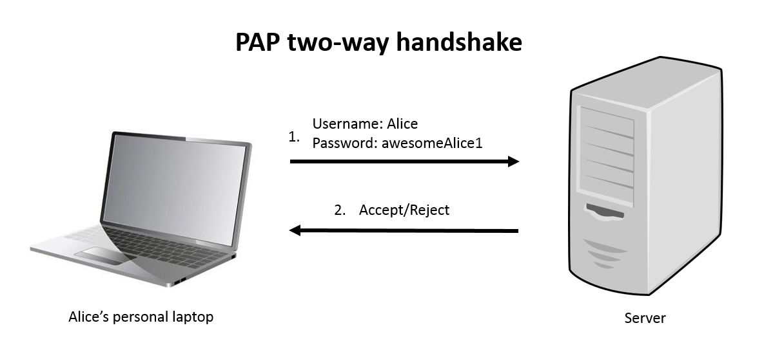
Protocol Example - Authentication
PAP - Password Authentication Protocol

Slide 34
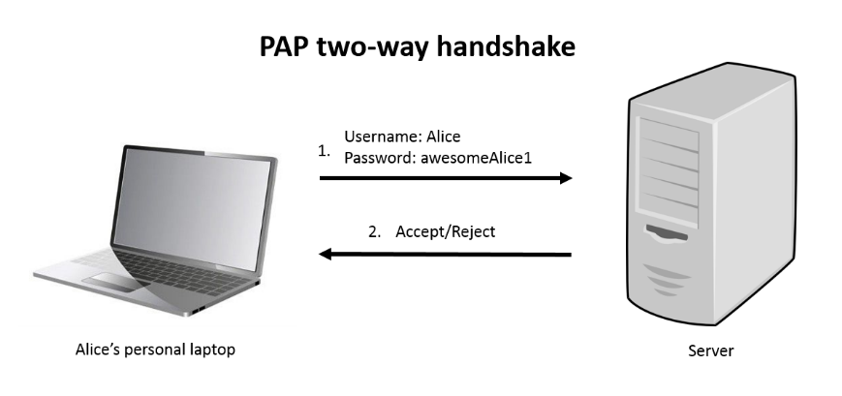
Protocol Example - Authentication
Client request contains bits in a specific order and of a specific length, per the standards and rules of the protocol:
1 byte | 1 | 2 bytes | 1 byte | Variable | 1 byte | Variable
Code: 1 | ID | Length | User name length | User name | Password length | Password
Notes:
This protocol requires a code, id, and lengths for the username/password be sent along in addition to the username and password themselves.

Slide 35
Protocol Example - Authentication
The server upon receiving the request will know where in the bit stream to look for the content – the username and password.
1 byte | 1 | 2 bytes | 1 byte | Variable | 1 byte | Variable
Code: 1 | ID | Length | User name length | User name | Password length | Password

Slide 36
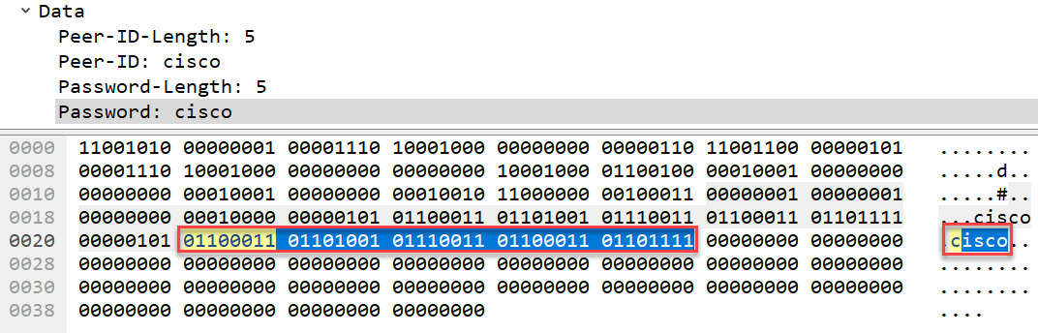
Protocol Example - Authentication
The protocol rules are shaped by the problem they’re trying to solve and the data being communicated.
With PAP, this means denoting exactly where in all of the bits sent the username and password are:

Slide 37
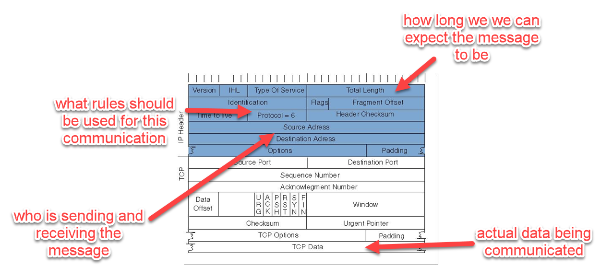
Protocols in Networking
TCP/IP (Transmission Control Protocol/Internet Protocol) header:
Notes:
Don’t get into the header info! Just an example
In networking, TCP (Transmission Control Protocol) and IP (Internet Protocol) help define information about how communication should take place, and what is being communicated.

Slide 38
Port Numbers and Ranges
0 to 1023 – System Ports
1024 to 49151 – Registered Ports
49152 to 65536 – Dynamic / Private Ports (Unregistered)
DNS - 53
Microsoft SQL Server - 1433
Notes:
Liken to a boat port

Slide 39
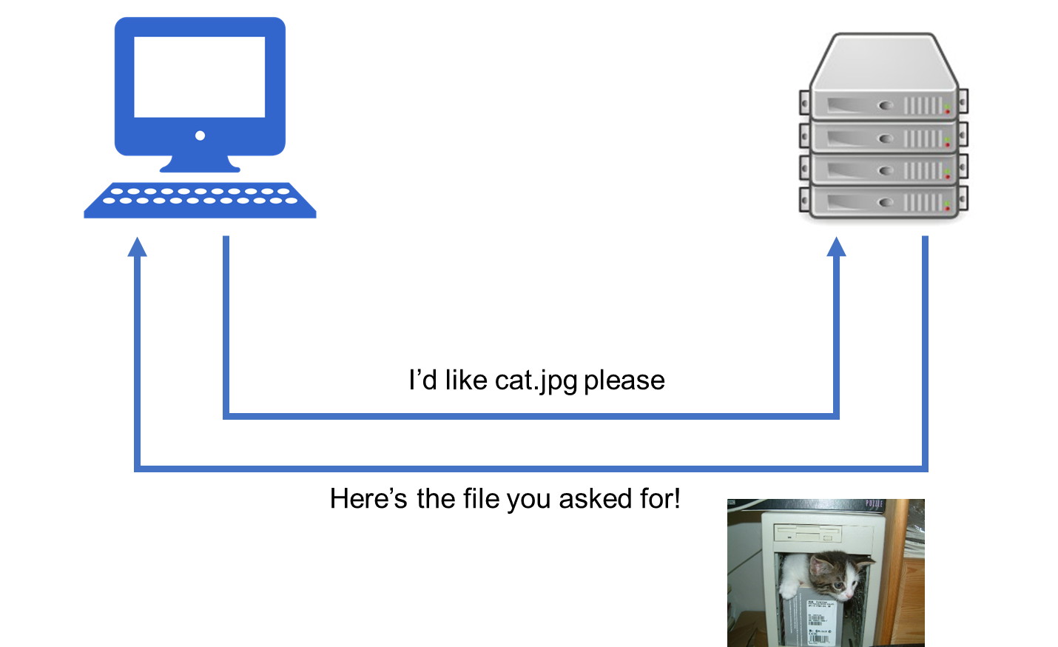
Source and Destination
Source Ports
Source ports are randomly generated from the unregistered port range.
Destination Ports
Dependent on the protocol
188.4.4.72
151.20.0.145
151.20.0.145 Port: 80
188.4.4.72 Port 50158
Notes:
Liken to a boat port

Slide 40
Activity: Protocols and Ports (10 min)
In this activity, you will be given a set of protocols. You will need to:
Identify its associated port number
Provide a brief description of the protocol
Instructions
Complete the activity using the file provided to you

Slide 41
Today’s Goals
By the end of class, you will be able to:
Define networks and understand the principles by which computers communicate
Explain the relevance of protocols and ports in network communication
Define and explain each layer of the OSI model
Explain the steps of network communication in the context of the OSI Model
Capture communication over the network using Wireshark
Explain the basics of a packet in Wireshark
Notes:
But today, we’re going to… Review goals, address questions.

Slide 42
The OSI Model

Slide 43

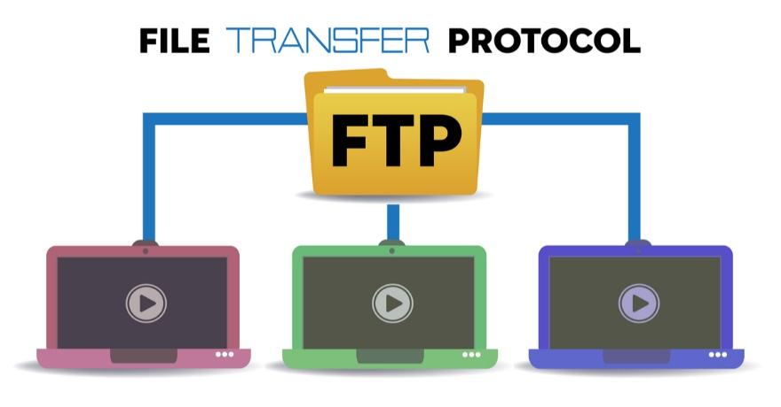
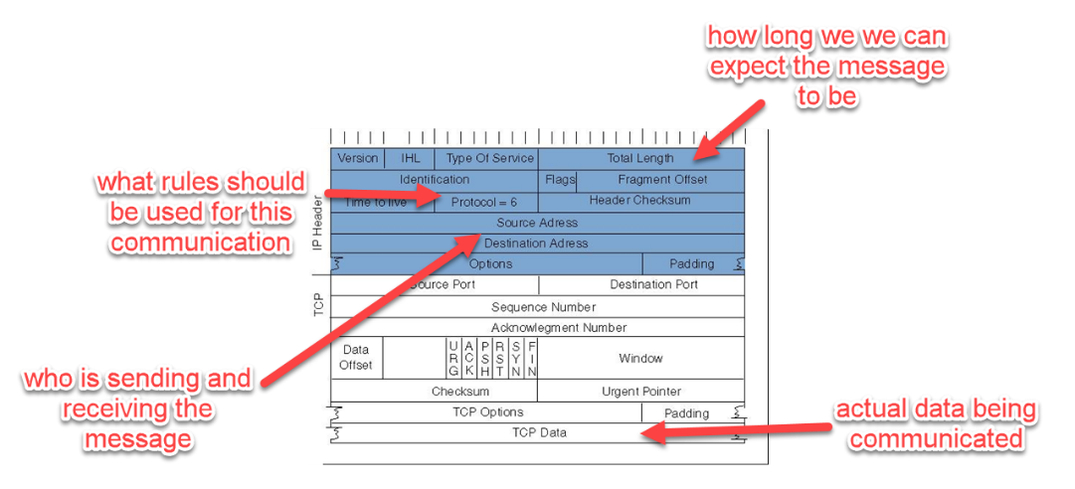
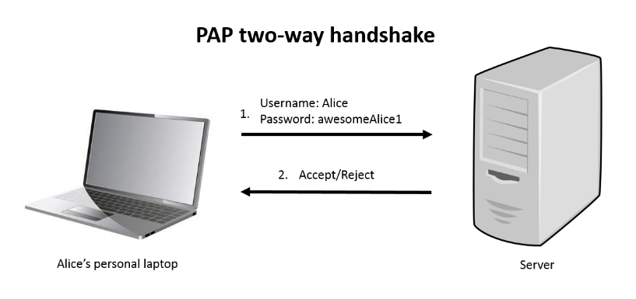
The OSI Model
Hundreds of protocols exist in computer networking

Slide 44
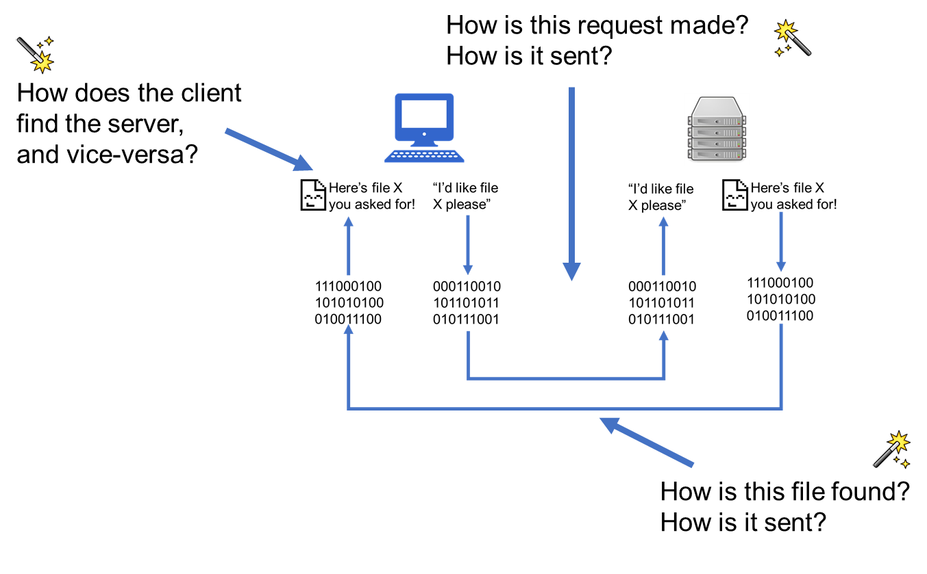
The OSI Model
Also, there’s still a lot of magic here.
Sure, Request/Response.
Sure, everything is communicated via 0s and 1s.
But how?

Slide 45

The OSI Model
That’s a lot of protocols and magic
Notes:
That might be intimidating

Slide 46
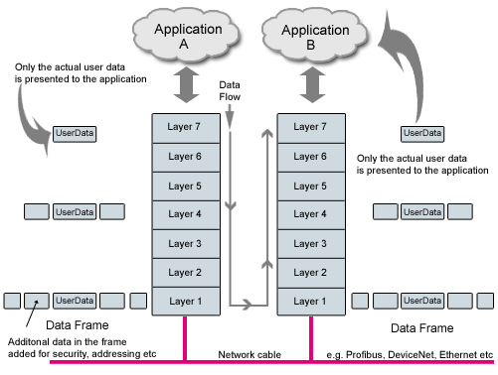
The OSI Model
Notes:
Point out that communication goes through each layer of the model, slowly growing the data frame to incorporate things like protocol information, security measures, and other information.

Slide 47
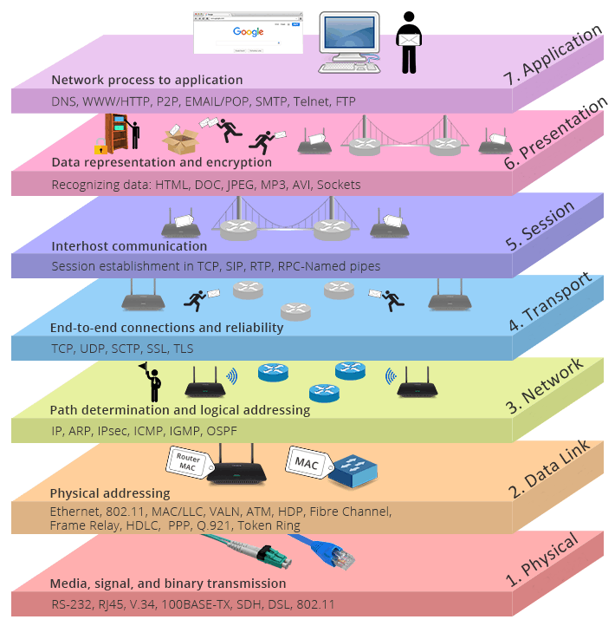
The OSI Model

Slide 48
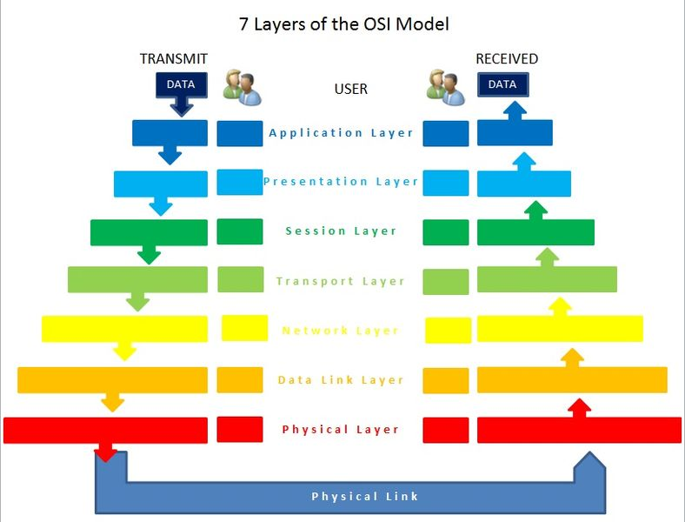
The OSI Model
Application
Presentation
Session
Transport
Network
Data Link
Physical

Slide 49
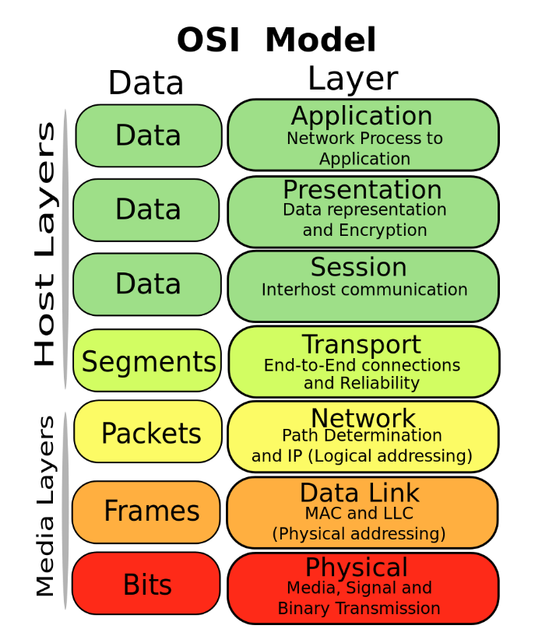
The OSI Model
Diving Into the Layers
Application
Presentation
Session
Transport
Network
Data Link
Physical
Pneumonics All People Seem To Need Data Processing
Please Do Not Teach Sales People Anything
People Don’t Need Those Stupid Packets Anyway (UDP joke)

Slide 50


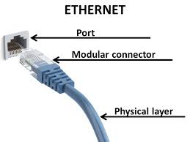
The OSI Model
Physical Layer
Application
Presentation
Session
Transport
Network
Data Link
Physical

Slide 51



The OSI Model
Data Link Layer
Application
Presentation
Session
Transport
Network
Data Link
Physical

Slide 52

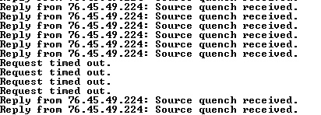
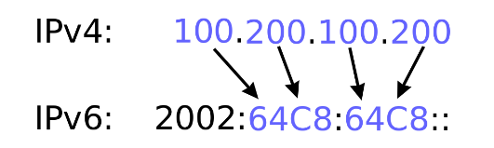
The OSI Model
Network Layer
Application
Presentation
Session
Transport
Network
Data Link
Physical

Slide 53

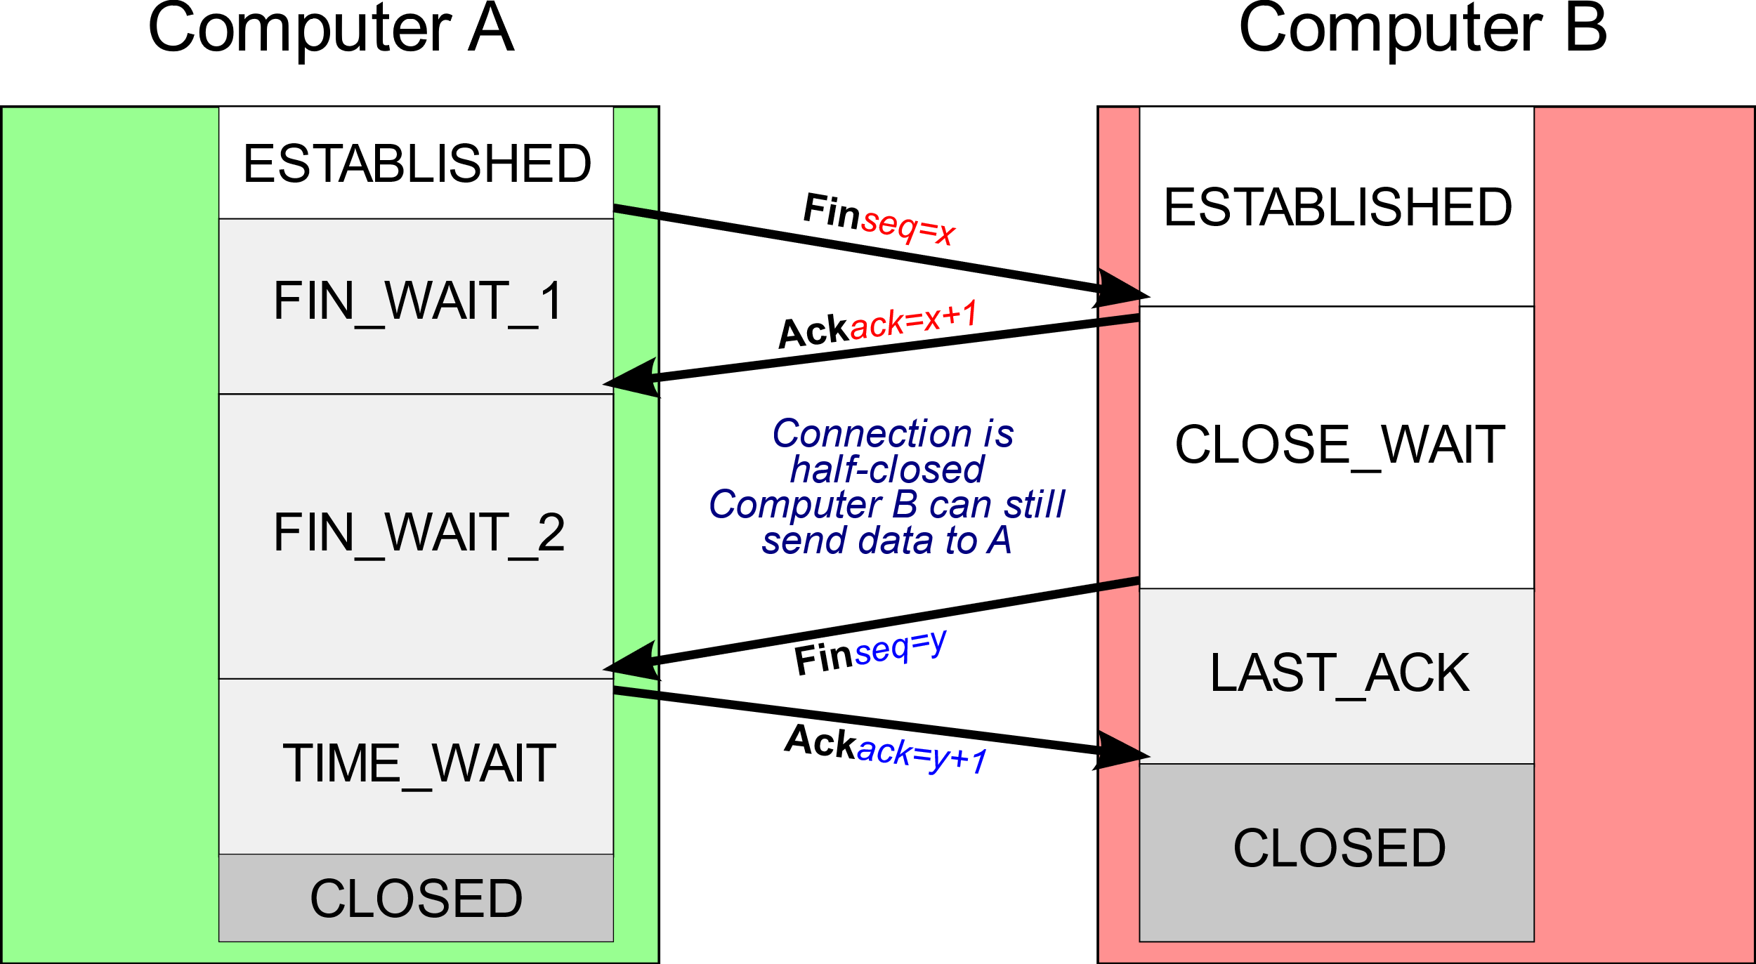
The OSI Model
Transport Layer
Application
Presentation
Session
Transport
Network
Data Link
Physical

Slide 54

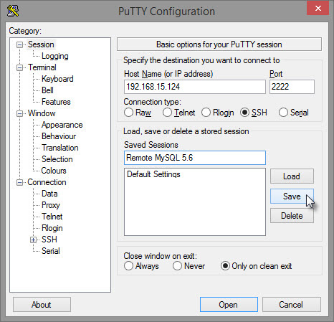

The OSI Model
Session Layer
Application
Presentation
Session
Transport
Network
Data Link
Physical

Slide 55



The OSI Model
Presentation Layer
Application
Presentation
Session
Transport
Network
Data Link
Physical
JPEG/GIF
ASCII
XML/JSON

Slide 56

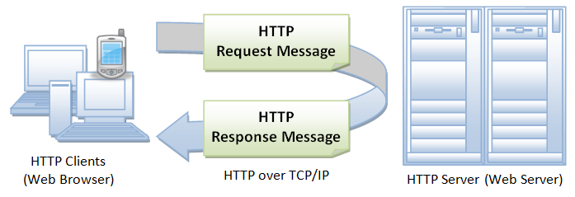
The OSI Model
Application Layer
Application
Presentation
Session
Transport
Network
Data Link
Physical

Slide 57
The OSI Model- Encapsulation and Decapsulation

Slide 58
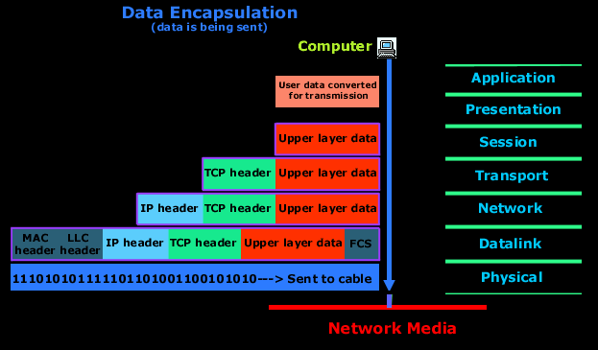
The OSI Model - Encapsulation

Slide 59
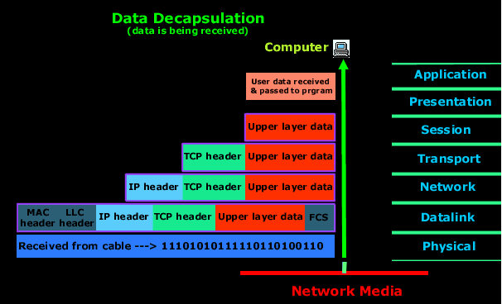
The OSI Model - Decapsulation

Slide 60
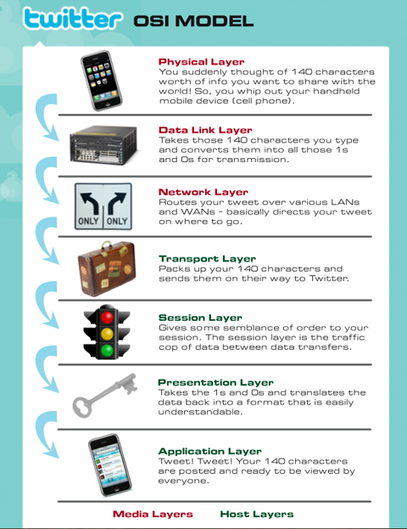
Twitter and the OSI Model

Slide 61
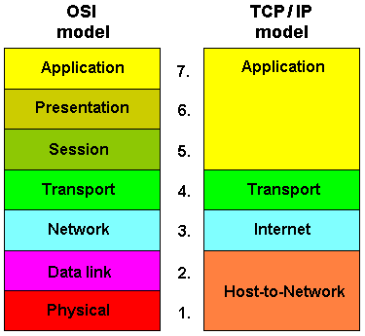
TCP/IP Model
Notes:
Explain that also used in the industry is the TCP/IP model, which is similar but with less granularity. Leave it at that.

Slide 62
Activity: Fill In the Blanks (10 min)
On a piece of paper, write out the numbers 1 through 9.
For each layer (starting at the bottom), give the following:
Layer Name
Function
Relevant Protocols
Any other information you know about the layer
For 8 and 9, explain the process that is labelled.
Bonus:
Draw your own version of the OSI Model, labelled.
8
9
7
6
5
4
3
2
1

Slide 63
Review Fill in the Blanks
8
9
7
6
5
4
3
2
1
8: Encapsulation
9: Decapsulation

Slide 64
Today’s Goals
By the end of class, you will be able to:
Define networks and understand the principles by which computers communicate
Explain the relevance of protocols and ports in network communication
Define and explain each layer of the OSI model
Explain the steps of network communication in the context of the OSI Model
Capture communication over the network using Wireshark
Explain the basics of a packet in Wireshark
Notes:
But today, we’re going to… Review goals, address questions.

Slide 65
Break (15 min)

Slide 66
Wireshark Basics

Slide 67
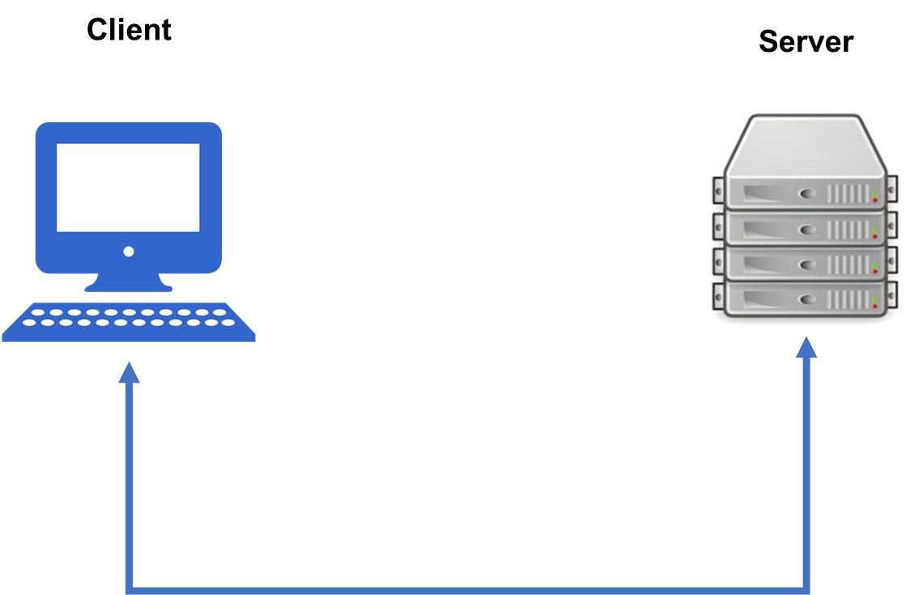
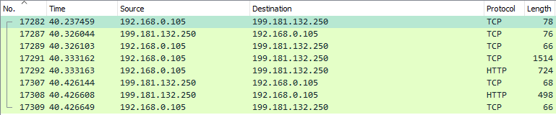
Wireshark
Notes:
https://www.indeed.com/jobs?q=wireshark&l=Atlanta%2C+GA

Slide 68
Wireshark
With Wireshark we can dive into network communication and start to pick apart the pieces

Slide 69
Packets
Packet Example - Email
Header | Sender’s IP Address, Receiver’s IP Address, Protocol, … | 96 bits
Payload | Data | 660 bits
Trailer | Indicate end of packet, error correction | 32 bits
Notes:
But today, we’re going to… Review goals, address questions.

Slide 70
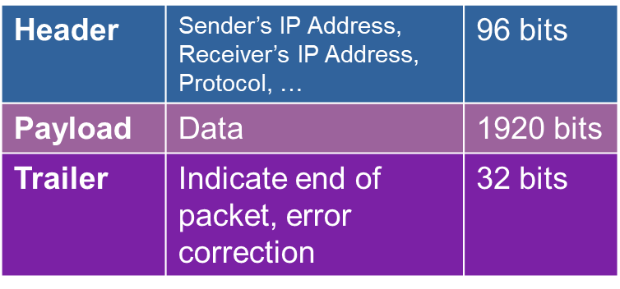
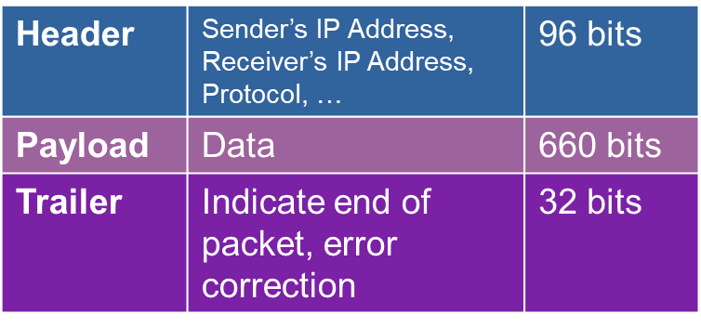
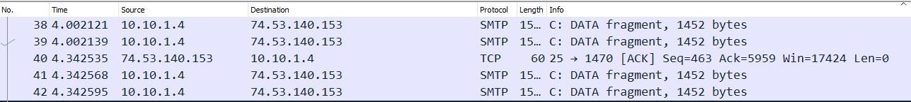
Message -> Packets -> Message
1
2
3
4 packets all part of the same email
Notes:
The good thing about this is that if a single packet gets corrupted or lost, only that packet needs to be resent.

Slide 71
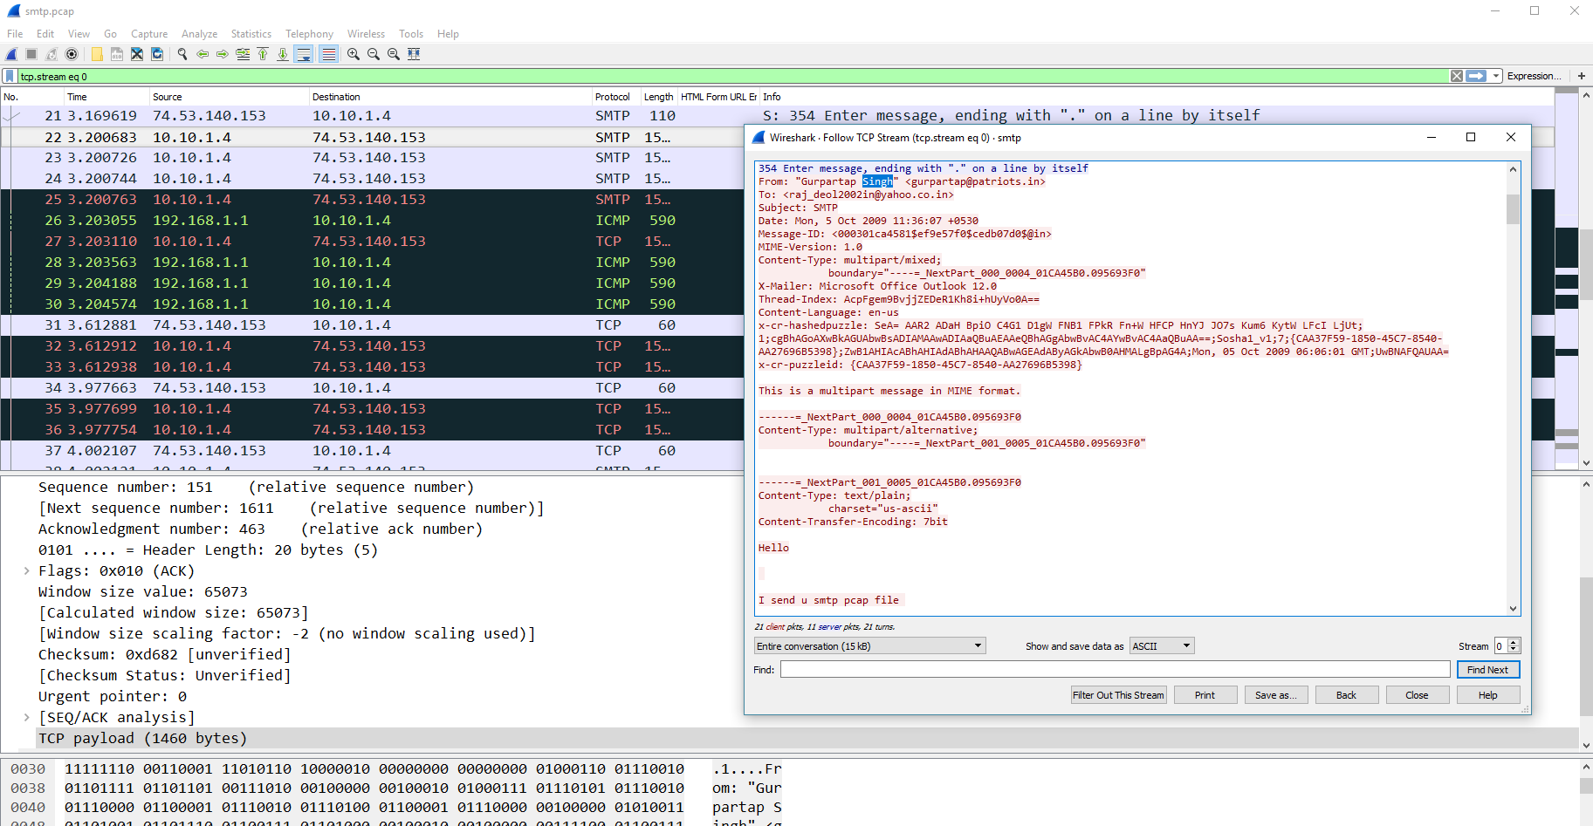
Packets in Wireshark

Slide 72
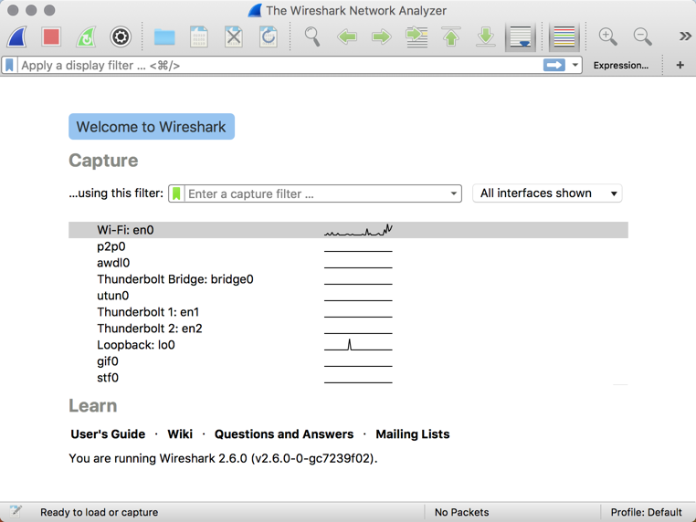
Activity: Install Wireshark Check (5 min)
Instructions:
Visit the Wireshark website (https://www.wireshark.org/) and proceed to download the application.
Follow the steps through the installation process. (Windows users: Be sure to "Select All" when prompted to "Select Components to Install").
Once installed, open the application. You should see a view that looks like this:
Bonus:
Navigate to the Wireshark User Guide and begin skimming through the first few chapters.
Start and stop a capture. See if you can find in the UI the “0s and 1s”, and also any recognizable communication.

Slide 73
Activity: Diving with the Wiresharks (15 min)
In this activity, you’ll conduct a capture and investigate a packet capture file and answer a series of questions about the traffic in the file.
Instructions:
Using your own exploration or the Wireshark documentation, complete the following steps and answer the associated questions:
First, "Start a Capture".
Allow the Wireshark capture to run for a few moments, before "Stopping" the capture.
Once stopped, take a few moments to answer the following questions in the worksheet provided. (Hint: You will need to do a bit of research!)

Slide 74
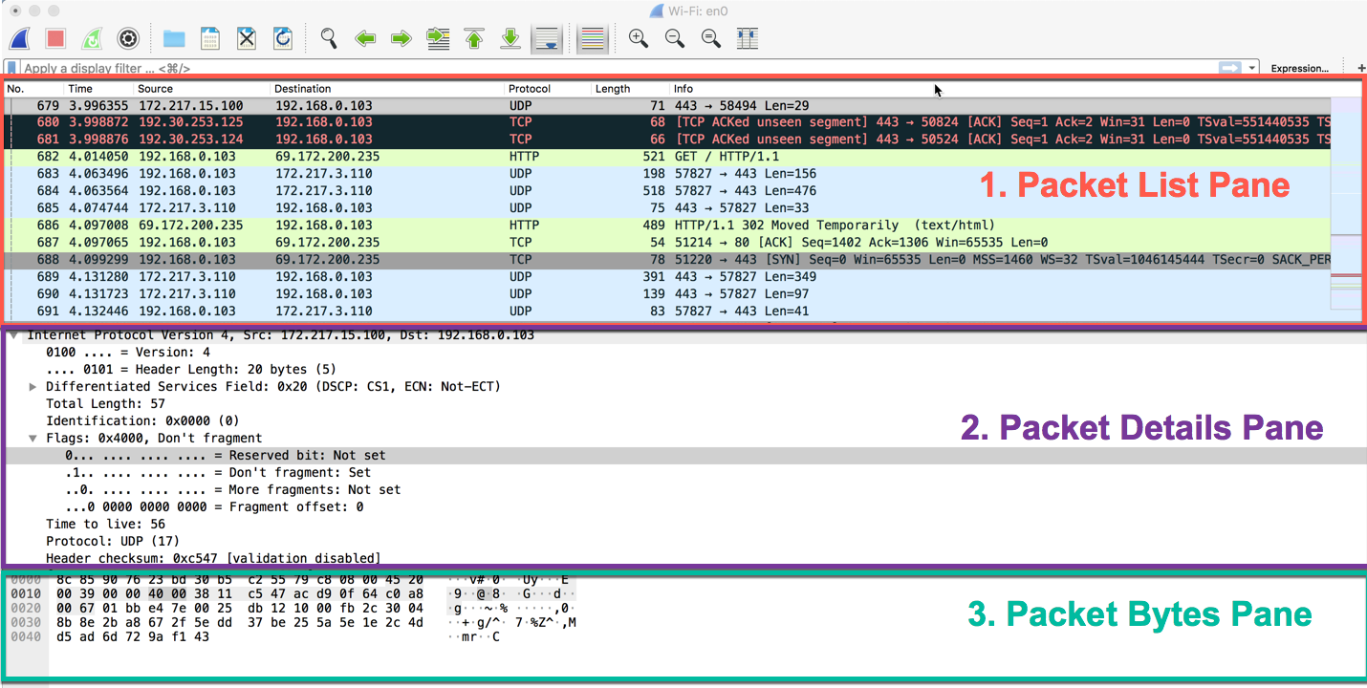
Review Diving with the Wiresharks

Slide 75
Activity: My First Sniff (10 min)
Instructions:
Spend a few moments identifying a website that is not secured through HTTPS.
As a suggestion, visit the whynohttps website (https://whynohttps.com/). While some have since been secured, many remain insecure.
Start a Wireshark capture and visit one of these pages. Stop the capture after a few moments and answer the following questions:
Which packets are relevant to your web browsing?
Which packets are relevant to your machine's request?
Which packets are relevant to the website's response?
If you are seeing many rows of requests and responses, why might this be the case?
Which packets contain the HTML markup of the website? (Hint: The packet should show text similar to what you see on the webpage.)
If you finish early, re-attempt this experiment, but this time use a website that *is* secure. What do you see this time? What might be the significance of HTTPS vs HTTP?

Slide 76
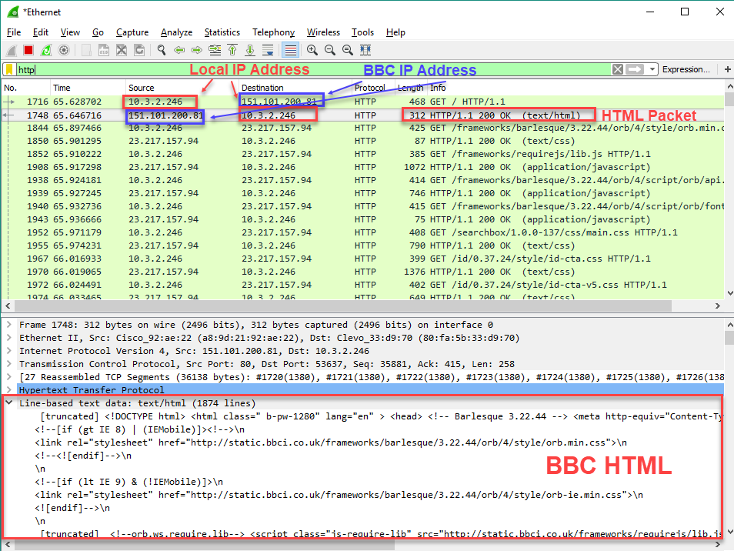
Review My First Sniff

Slide 77
Today’s Goals
By the end of class, you will be able to:
Define networks and understand the principles by which computers communicate
Explain the relevance of protocols and ports in network communication
Define and explain each layer of the OSI model
Explain the steps of network communication in the context of the OSI Model
Capture communication over the network using Wireshark
Explain the basics of a packet in Wireshark
Notes:
But today, we’re going to… Review goals, address questions.

